Slide 1
Simulation on Dual-loop DC Motor Drives
Design and simulate a dual-loop DC motor drive system as shown below by using MATLAB/SIMULINK.
Power source: 3-phase 380V 50Hz;
Power electronics converter:
Diode rectifier + Switching mode full bridge converter
3) DC Motor model: DC machines
Preset model: 01 5HP 240V
1750rpm Field:300V
Mechanical output: Speed
4) PWM method: optional
三相电源
触发控制电路
u
c
ACR
i
i
∗
ASR
n
+
n*

Slide 2
1. Design ASR and ACR and determine their parameters. The output limit for ASR is 20, and the output limit for ACR is 300;
2. Simulate the system operating with step change from 1250rpm to 1500rpm without load;
3. Simulate the system operating at 1500rpm without load at the initial, and then with a load change of 8Nm at t=2.5sec;
3. Give the input and output of each section in steady-state;
5. Discuss the effects and influences of Kp, Ki and output limit.
Notes:
The basic principle is to speed up the acceleration process with minimum overshoot;
Design the regulator parameters by control theory first and then adjust them manually;
Determine the parameters of ACR (inner loop) first and then adjust the parameters of ASR (outer loop).
Notes:
1. 设计ASR和ACR，确定其参数。ASR的输出限制为20,ACR的输出限制为300;
2. 模拟系统在无负载情况下从1250rpm到1500rpm的步长变化;
3. 模拟系统初始空载转速为1500rpm，t=2.5秒时负载变化8Nm;
4.给出稳态下各分段的输入输出;
5. 讨论了Kp、Ki和输出极限的作用和影响。
注:
其基本原理是以最小的超调加速过程; 先用控制理论设计调节器参数，再人工调节; 先确定ACR(内环)参数，再调整ASR(外环)参数。

Slide 3
注：除之前作业中曾用过的元件外，本次仿真可能用到的元件：
1. Control & MeGenerator:产生阶跃信号。
asurements->Pulse & Signal Generators->Stair
2. Fundamental Blocks->Machines->DC Machine:直流电机。
3. Simulink->Continuous->PID Controller:控制PI参数。
4. Simulink->Continuous->Transfer fcn:设置传递函数

Slide 4
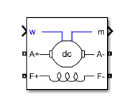
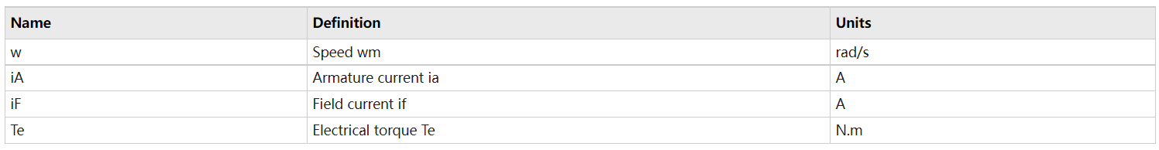
DC Machine
Inputs and Outputs
TL: The block input is the mechanical load torque, in N.m.
W: The alternative block input (depending on the value of the Mechanical input parameter) is the machine speed, in rad/s.
m
The output of the block is a vector containing measurement signals. You can demultiplex these signals by using the Bus Selector block provided in the Simulink library.
Notes:
https://ww2.mathworks.cn/help/sps/powersys/ref/dcmachine.html?s_tid=srchtitle_dc%20machine_1#f3-2394498

Slide 5
Stair Generator
转速调节器（ASR）的作用： 1）转速调节器是调速系统的主导调节器，它使转速很快地跟随给定电压变化，如果采用PI调节器，则可实现无静差。2）对负载变化起抗扰作用。3）其输出限幅值决定电动机允许的最大电流。
电流调节器（ACR）的作用： 1）在转速外环的调节过程中，使电流紧紧跟随其给定电压（即外环调节器的输出量）变化。2）对电网电压的波动起及时抗扰的作用。3）在转速动态过程中，保证获得电动机允许的最大电流。4）当电动机过载甚至堵转时，限制电枢电流的最大值，起快速的自动保护作用。一旦故障消失，系统立即自动恢复正常。
Notes:
https://ww2.mathworks.cn/help/sps/ref/stairgenerator.html?s_tid=srchtitle_stair%20generator_1

Slide 6
Devices and Parameters

Slide 7
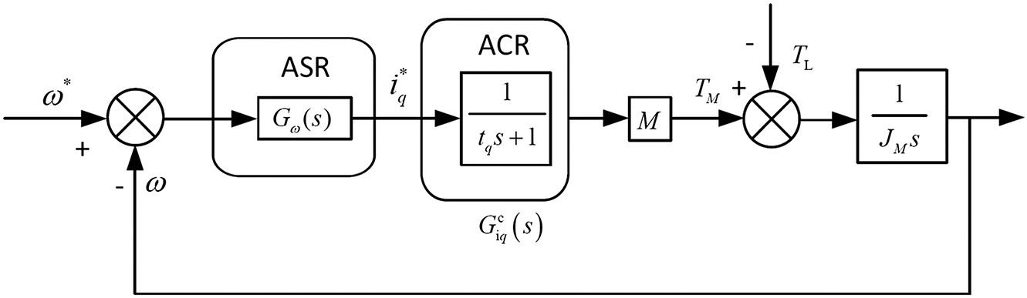

Slide 8
